Slide 1
Data Mining
Prepared for CS527
By: Josh Levine, Pranav Shivkumar, Shounak Rangwala, Pratik Mistry, Swapnil Kamate, Vikhyat Dhamija

Slide 2
Introduction to assignment
To select the targets and top 10 probes from the “Genome” wide data set and to transfer the data to RDBMS in a new table
To create models for KNN classification and K-means clustering on above data
To create Recommendation System based on Instacart Dataset

Slide 3
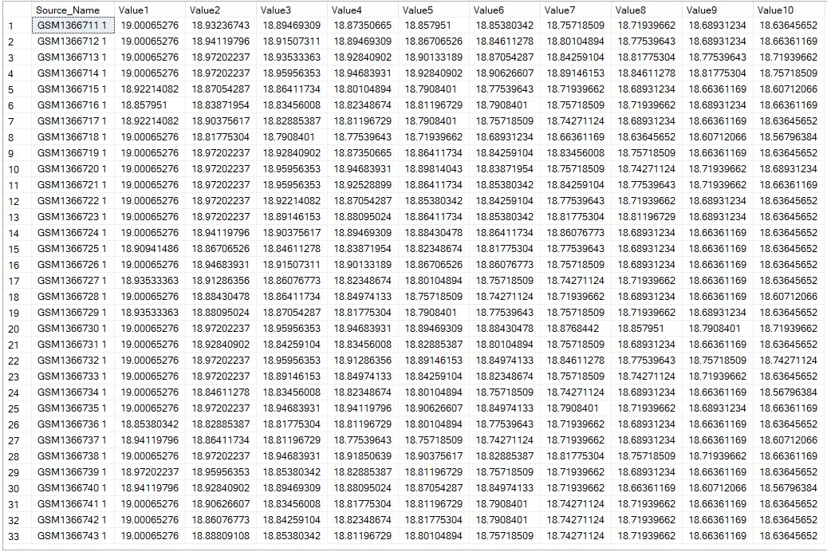
Task 1: Upload Data from Wide Dataset
Query Result : Select * from Genome1;
Data Uploaded

Slide 4

Task 2: KNN Classification Model
KNN: K-nearest neighbor
A simple machine learning algorithm which uses existing data to classify new data points.
Algorithm uses existing data points and calculates the ‘Distance’ between the test points and existing data points
The target is classified based on the minimum distance i.e. by finding “Closest Neighbour” to the test points

Slide 5
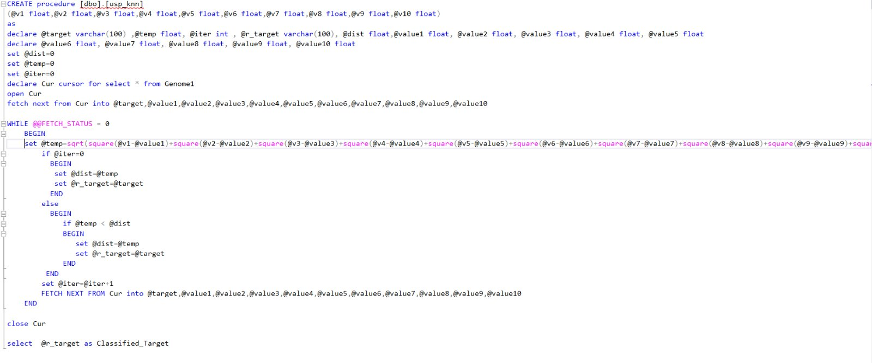
Task 2: Stored KNN Procedure

Slide 6

Query Results
Execution of the stored procedure usp_knn:
exec dbo.usp_knn 19.00065276,18.93236743,18.89469309,18.87350665,18.857951,18.85380342,18.77539643,18.68931234,18.66361169,18.63645652

Slide 7
Task 3: K-Means Clustering Model
K-means clustering is one of the popular unsupervised machine learning algorithms
The objective of K-means is to group similar data points together to form a fixed number (k) clusters in a dataset
K-means algorithm identifies k number of centroids, and then allocates every data point to the nearest cluster corresponding to the centroids
Then we average the data belonging to particular cluster to find the new centroid
It halts creating and optimizing clusters when either:
The centroids have stabilized — there is no change in their value because the clustering has been successful.
The defined number of iterations has been achieved.

Slide 8
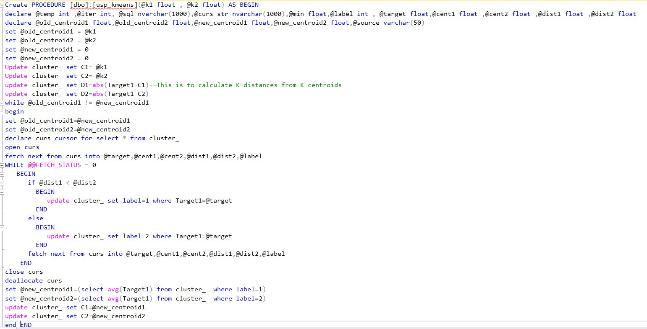
Task 3: K-Means Clustering

Slide 9
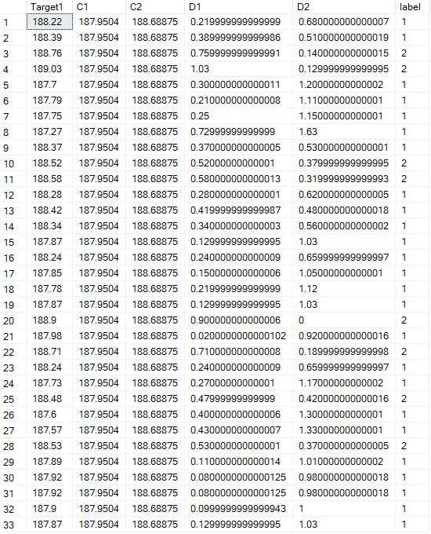
RESULT:
exec dbo.usp_kmeans 188 ,188.9

Slide 10
Task 4: Recommendation System
The data:
Using the instacart data
Order_products
Products
Because the data is so large we used a subset of the data
Identified a large number of orders and grabbed all the products from those orders.

Slide 11
Task 4: Market Basket Table
Create a lookup table with the structure: Product A, Product B, Frequency
To achieve this we create two views
Order_products_combos
Creates combinations for all products within an order
Products_combos
Creates combinations for all products in the table

Slide 12
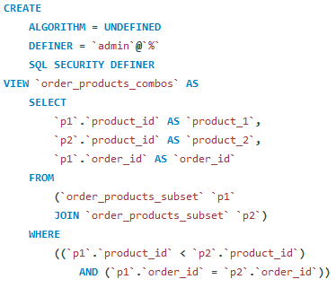
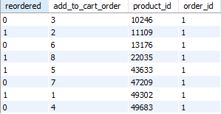
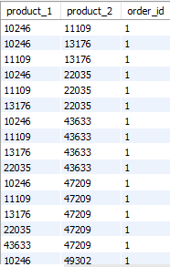
Order_products_combos
Above is order_products table where order_id = 1.
To the right is a preview of order_products_combos for order_id = 1

Slide 13
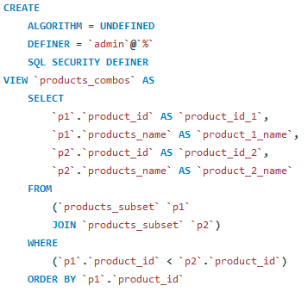
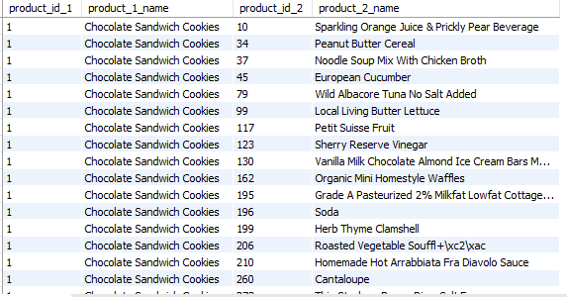
products_combos
Reminder: The reason we are seeing product_id_2 starting at 10 is because we used a subset of data to complete the task.

Slide 14
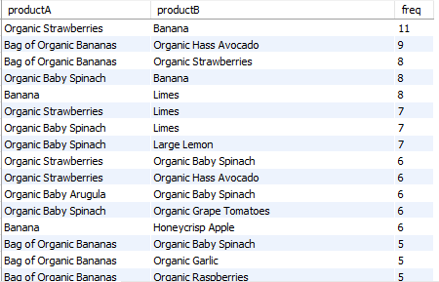
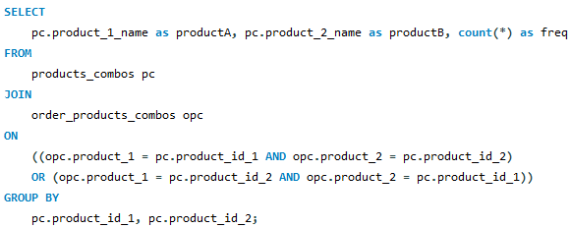
Market Basket Table
Created as a view using a join query.
Joined both the order_products_combos and the product_combos tables.

Slide 15
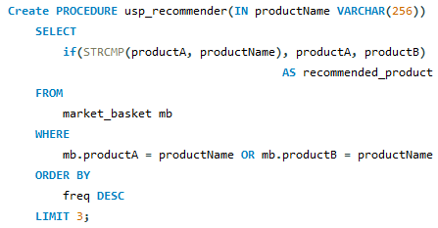
Procedure: usp_recommender
If statement: checks if product A = the product name passed. If so select the other product name.
Limit 3: selects the top 3 because we are ordering by frequency descending.

Slide 16
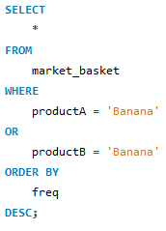
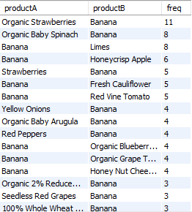

Usp_recommender: Results Confirmed
Top 3 recommended products purchased with Bananas.
We can confirm these results are correct.

Slide 17
Thank You

